Slide 1
Classroom Training - Days
Azure: 10 to 12 Hours
Azure DevOps: 6 to 8 Hours
Data Factory: 4 to 6 Hours
Data Bricks: 6-8 Hours

Slide 2
Expectations for successful training
Participants and the trainer should present the class as per the training schedule and be on time
Participants should focus on the labs considering the time allocated to each lab.
Since participants takes their time and the speed of each may vary, they need to give some extra efforts during or after the training and trainer should be available for the same on request
Trainer will also provide the hands-on material separately and participants can use that material to do the hands-on offline as well.

Slide 3
Cloud Computing
Duration: 10-20 Minutes
Notes:
https://courses.cs.washington.edu/courses/cse403/13au/lectures/git.ppt.pdf
http://enos.itcollege.ee/~jpoial/allalaadimised/git/getting-started-with-git.pdf

Slide 4
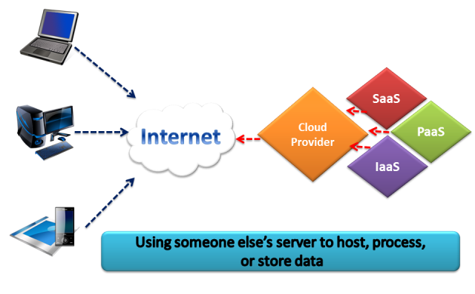
What is Cloud?

Slide 5
Characteristics
On-demand self-service
Consumer can provision resourced as needed automatically
Broad network access
Are available over network
Resource pooling
The provider’s resources are pooled to serve multiple consumers
Measured Service
Resource usage can be monitored and controlled providing transparency.
Used for billing
Rapid elasticity
Scale rapidly outward and inward
No human interaction

Slide 6
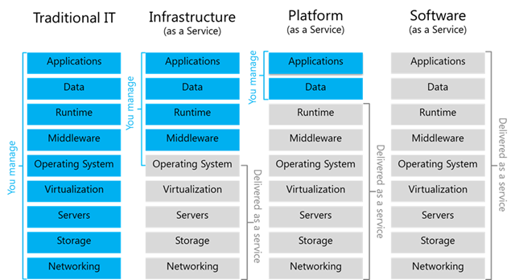
Cloud Services Deployment Models

Slide 7
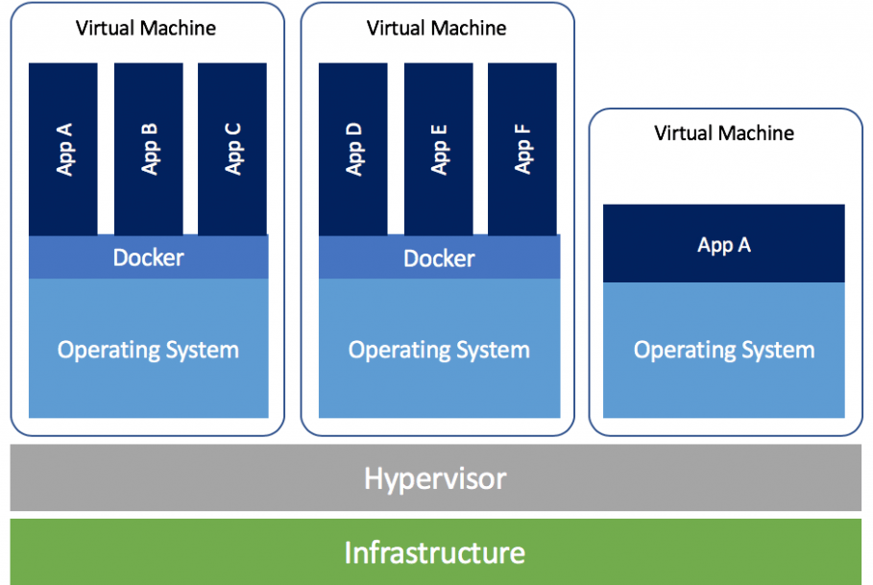
Virtual Machines
VM technology allows multiple virtual machines to run on a single physical machine

Slide 8
Microsoft Azure Fundamentals
Duration: 40-60 Minutes including labs

Slide 9
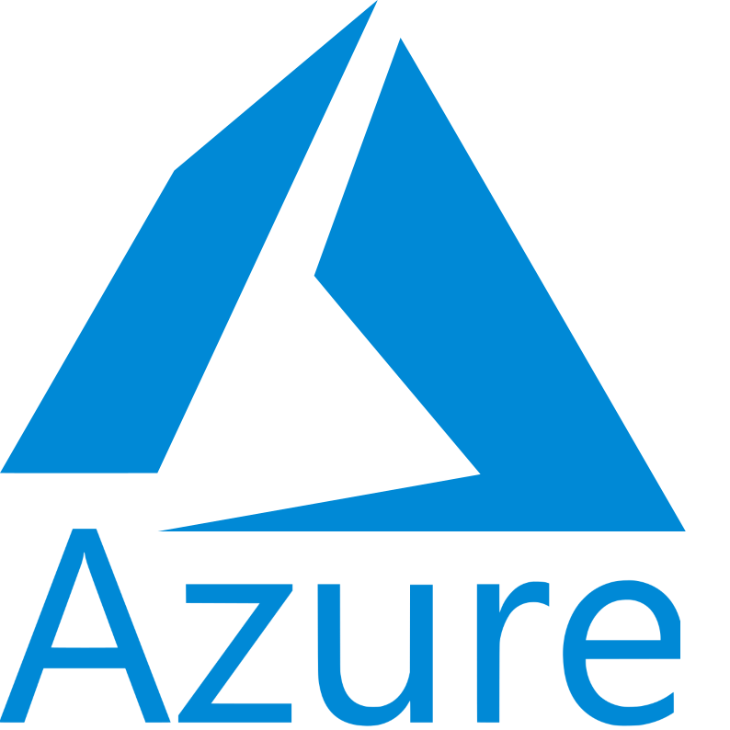
Introduction of Microsoft Azure
Microsoft's public cloud platform
Azure offers a large collection of services
PaaS
IaaS
managed database service capabilities

Slide 10
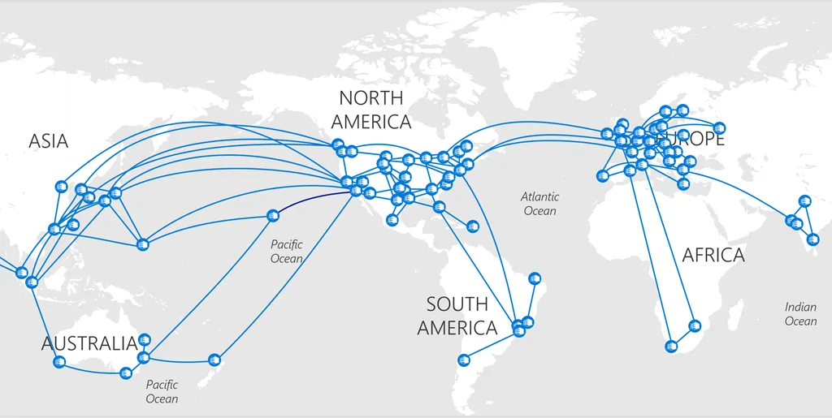
Concept of Region & Availability Zone

Slide 11
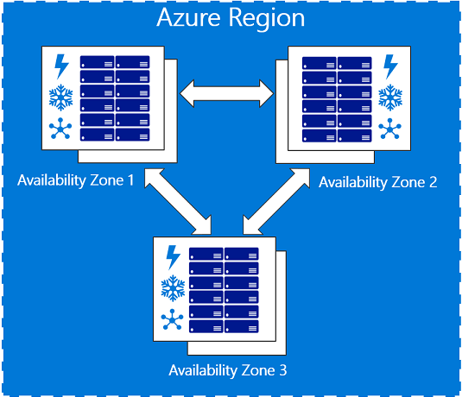
Concept of Region & Availability Zone

Slide 12
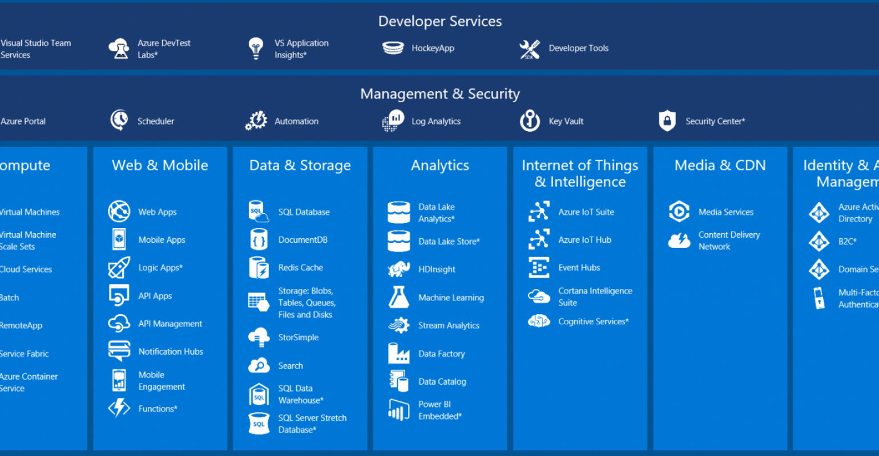
Azure Services

Slide 13
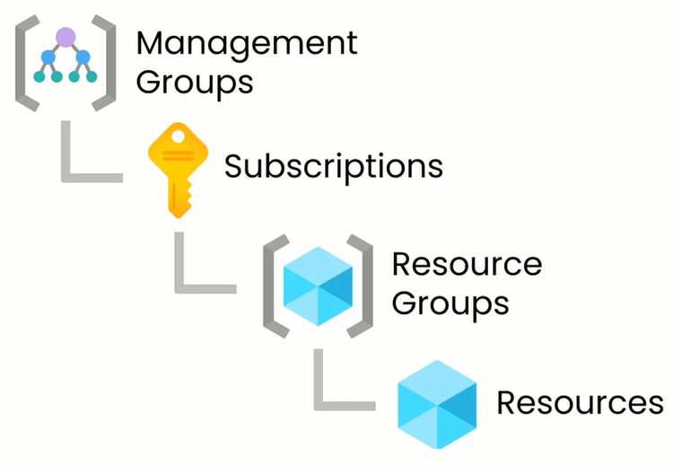
Concept of Resource Group

Slide 14
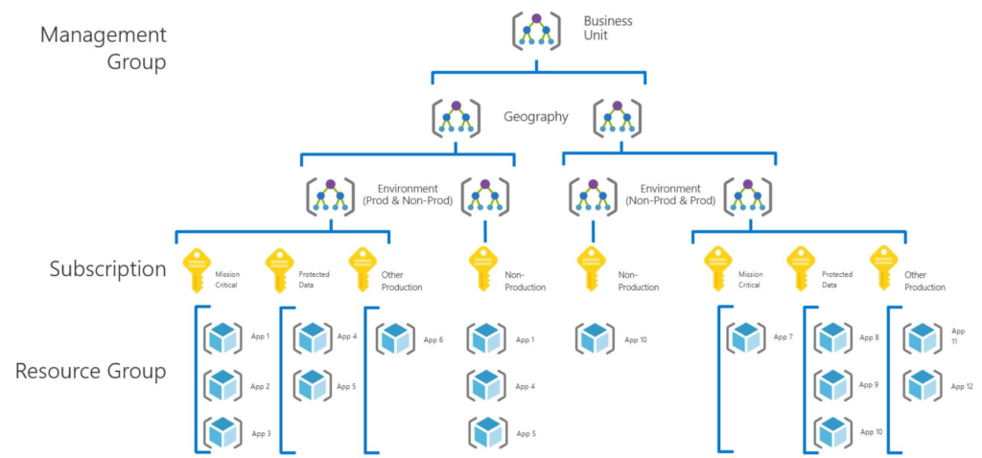
Concept of Resource Group

Slide 15

Introduction of Azure Virtual Machine

Slide 16
Lab: Planning and implementing VM

Slide 17
Lab: Creating virtual Machine using Portal
Duration: 10 minutes

Slide 18
Lab: Creating virtual Machine using CLI
Duration: 10 minutes
Commands
az group create --name rgAtinGupta --location eastus
az vm create --resource-group rgAtinGupta --name vmAtinGuptaCLI --image win2016datacenter --public-ip-sku Basic --admin-username azureuser

Slide 19
Azure Storage Account
Duration: 40-60 Minute with Labs

Slide 20
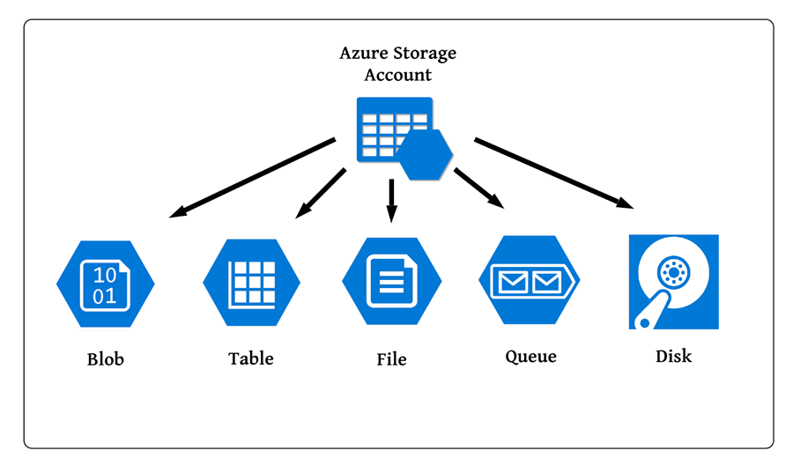
Introduction to Storage Account
Provides a unique namespace in Azure for data

Slide 21
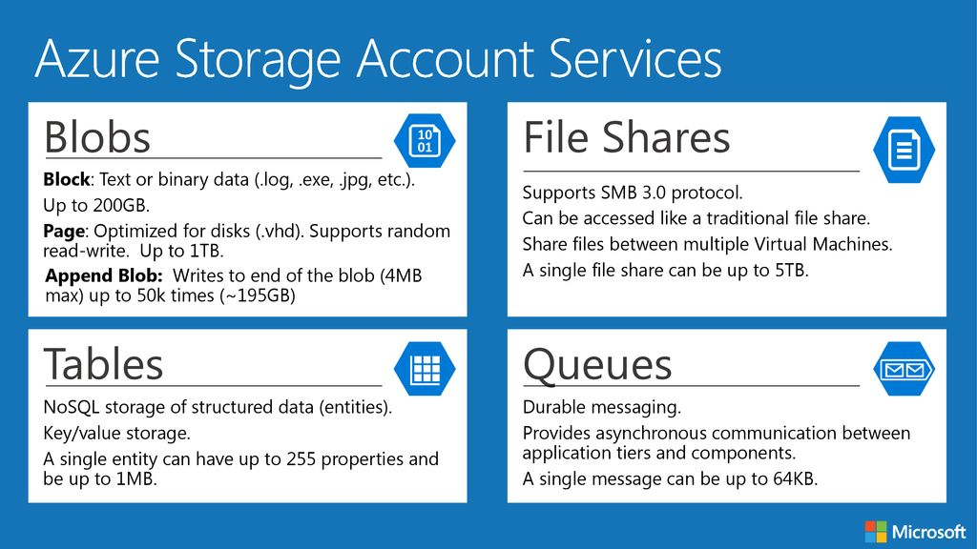
Core Storage Services

Slide 22
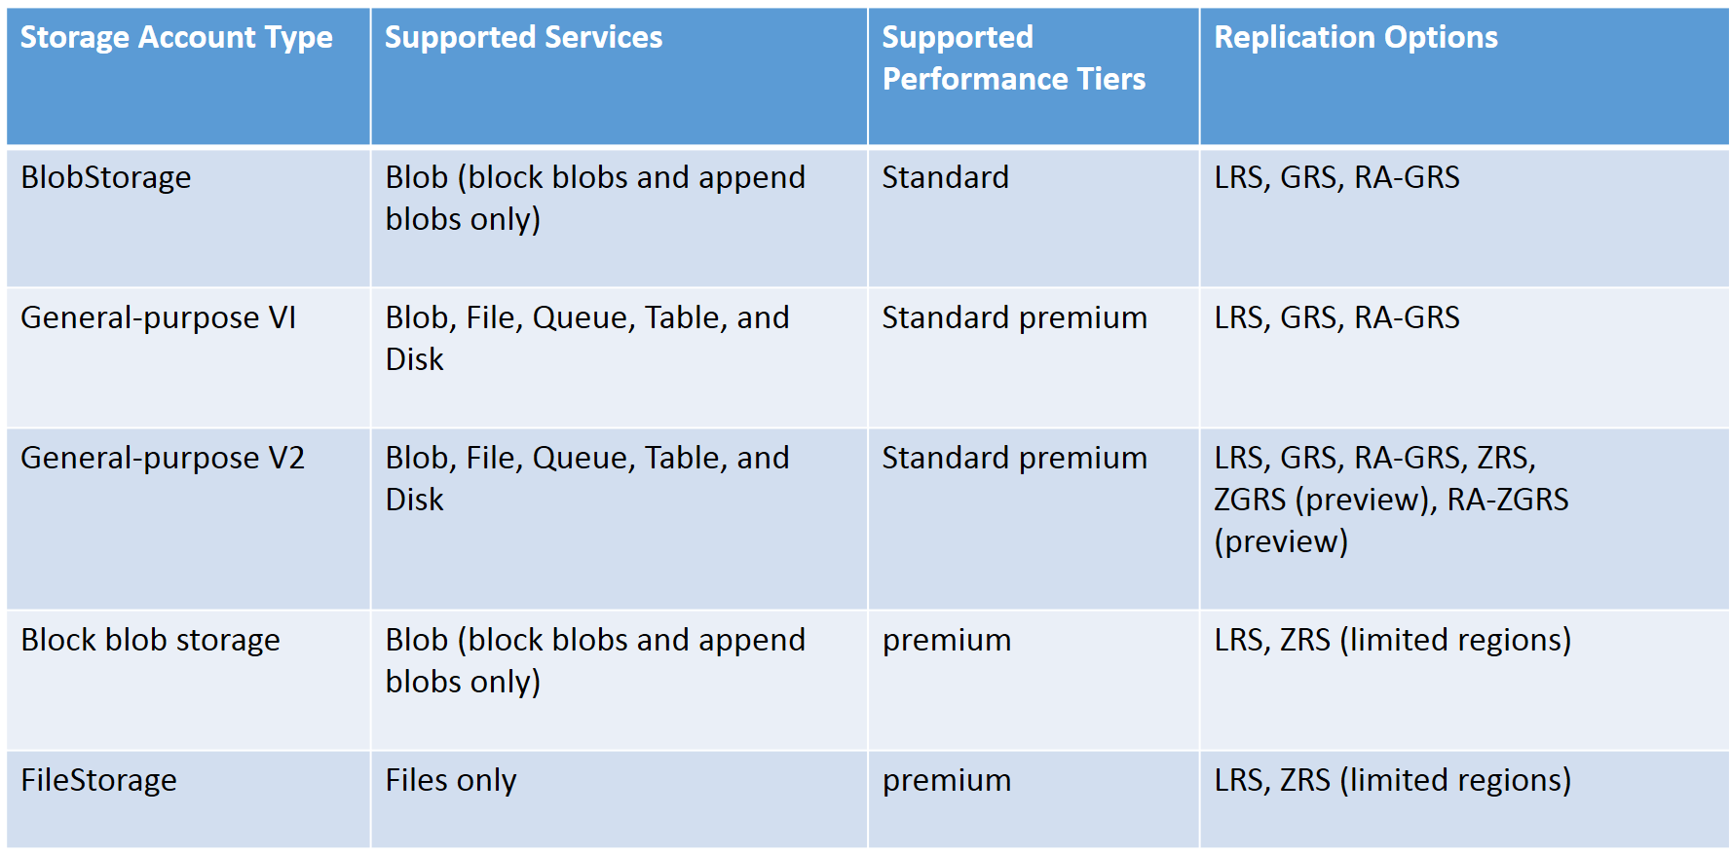
Types of Storage Accounts

Slide 23
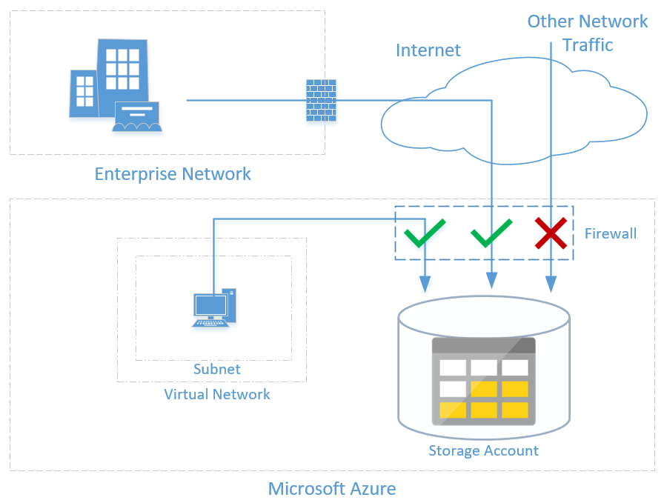
Securing the Data

Slide 24
Lab : Planning and implementing storage

Slide 25
Lab: Creating and manage Storage Accounts
Duration: 5 minutes

Slide 26
Lab: Create and manage containers
Duration: 10 minutes

Slide 27
Lab: Create & manage Blobs, Queues, Files & Tables
Duration: 10 minutes

Slide 28
Azure Management and Governance
Duration: 2-3 hours including labs

Slide 29
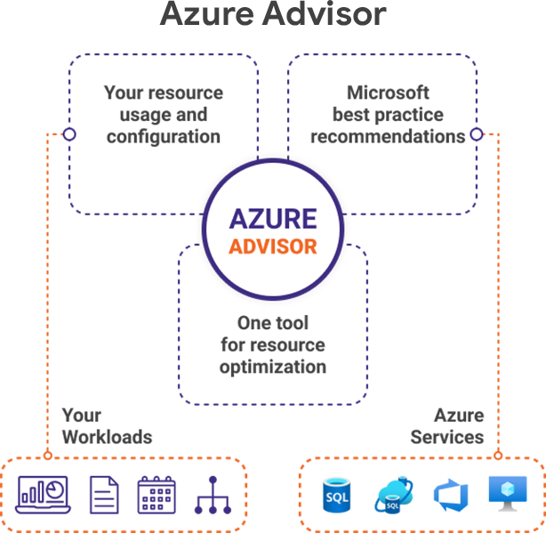
Concept of Azure Advisor
Analyses configurations and usage telemetry
Offers recommendations to help to optimise Azure resources
For reliability, security, operational excellence, performance and cost

Slide 30
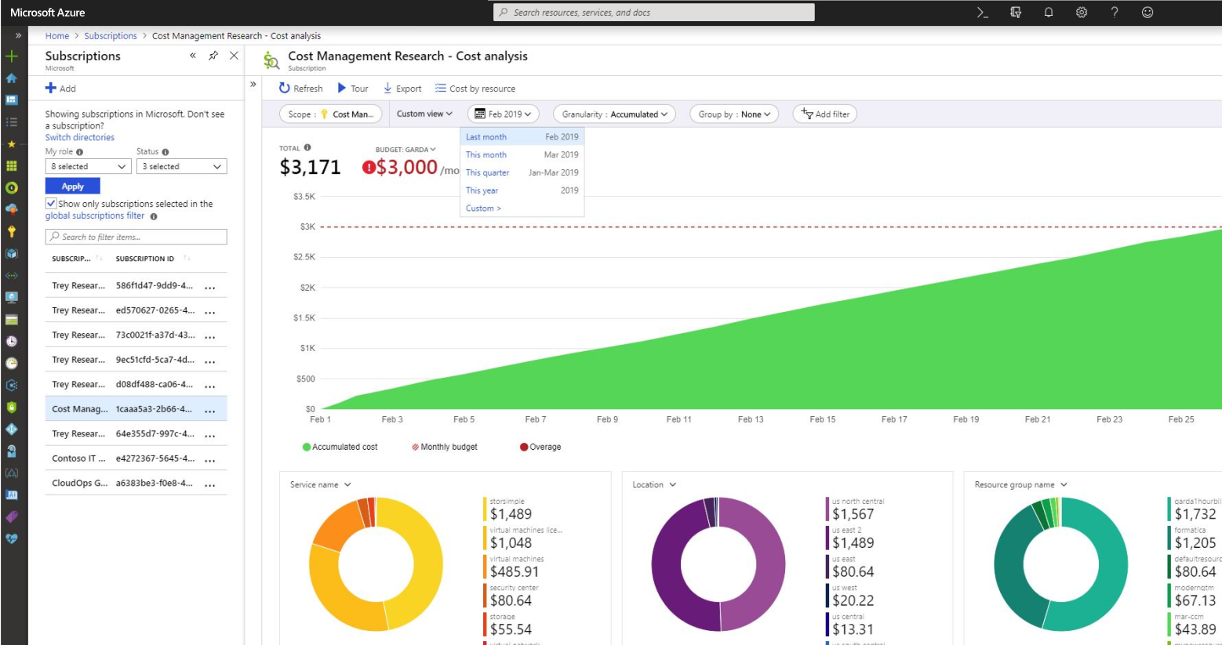
Cost management
Provides information about your overall costs and utilization

Slide 31
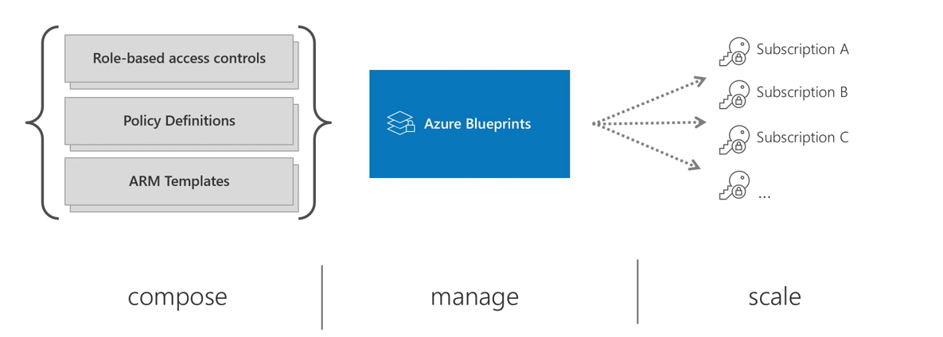
Azure Blueprints
To design and deploy a repeatable collection of Azure resources
Adhere to certain requirements and standards
Can quickly build and deploy new environments that are always compliant with organizational standards

Slide 32
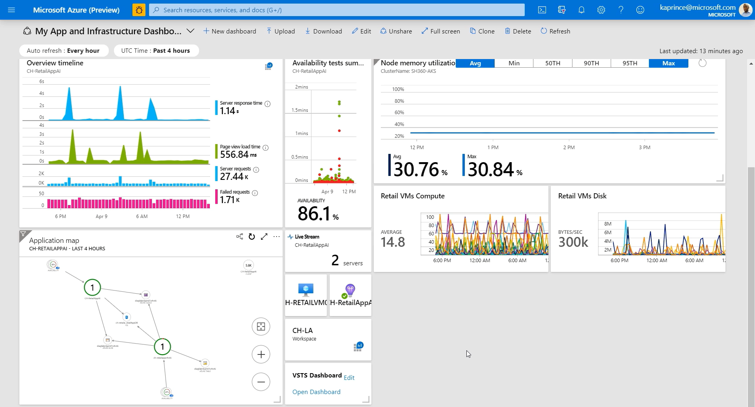
Azure Dashboard
Focused and organized view of your cloud resources in the Azure portal.

Slide 33
Lab : Azure Management and Governance

Slide 34
Lab: Creating Azure Advisor
Duration: 10 minutes
Sign in to the Azure portal.
In the left pane, click Advisor. ...
The Advisor dashboard will display a summary of your recommendations for all selected subscriptions. ...
To get recommendations for a specific category, click one of the tabs: Reliability, Security, Performance, or Cost.

Slide 35
Lab: Understand concept of Cost management & billing
Duration: 10 minutes

Slide 36
Lab: Implementation of Azure Blueprints
Duration: 30 minutes

Slide 37
Azure Networking
Duration: 2 to 3 hours including Labs

Slide 38
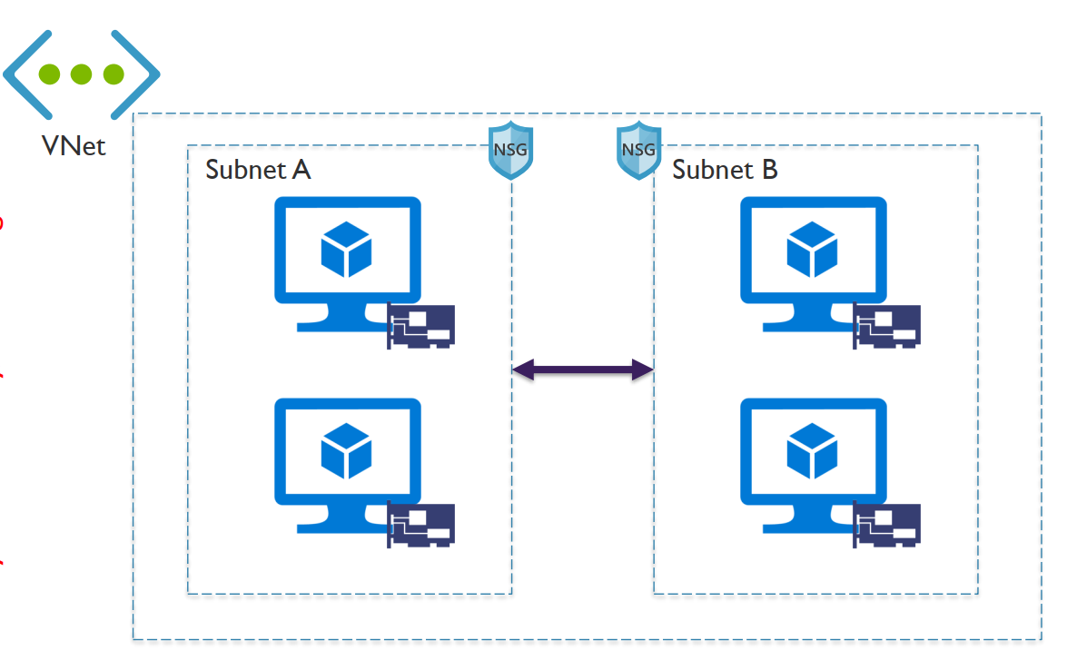
Introduction of VNet and Security Group
Fundamental building block for private network in Azure
Enables many types of Azure resources to securely communicate with each other

Slide 39
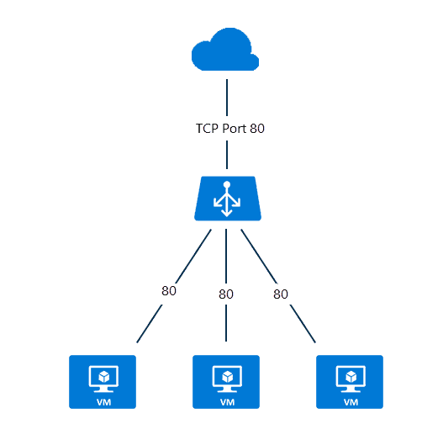
Concept of azure load balancer
Layer 4 load-balancing service
Built to handle millions of requests per second

Slide 40
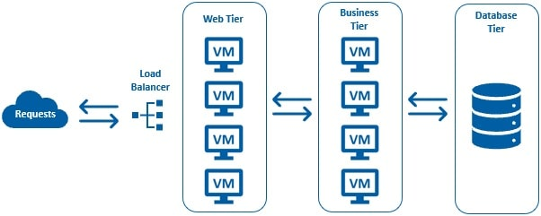
Azure Virtual Machine Scale
To create and manage a group of load balanced VMs
The number of VM instances can automatically increase or decrease in response to demand or a defined schedule

Slide 41
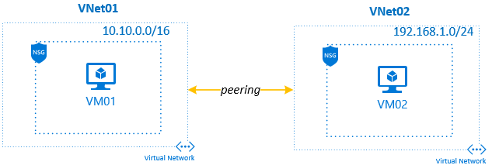
VNet Peering
Enables to seamlessly connect two or more Virtual Networks in Azure

Slide 42
Lab: Azure Networking

Slide 43
Lab: Implementation of VNet
Duration: 15 Minutes

Slide 44
Lab: Configure of public and private LB
Duration: 40 Minutes

Slide 45
Lab: Configuration of VM scale Set
Duration: 20 Minutes

Slide 46
Lab: Implementation of global and local peering
Duration: 20 Minutes

Slide 47
Azure AD Authentication
Duration: 1.5-2 hours including labs

Slide 48
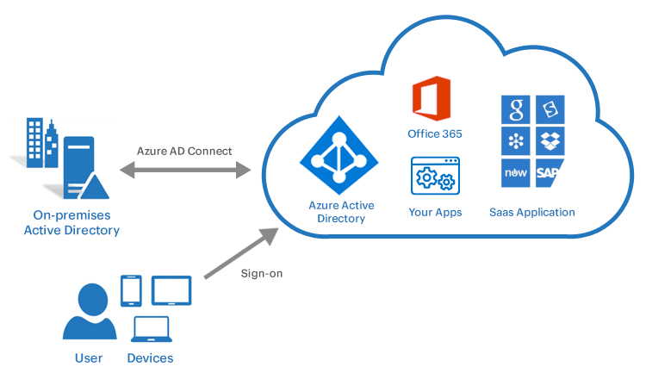
What is Azure Active Directory?
Cloud-based identity and access management (IAM) solution
Provides
Single sign-on
Conditional access to guard against 99.9 percent of cybersecurity attacks.
Multifactor authentication

Slide 49
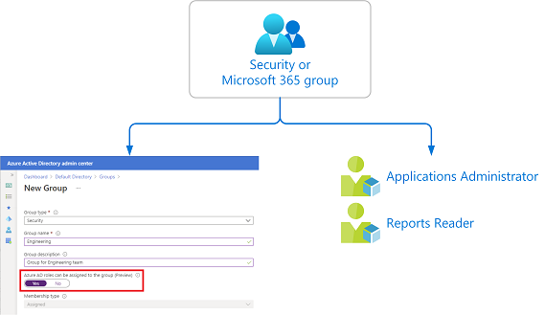
User, Groups & Audit Logs

Slide 50
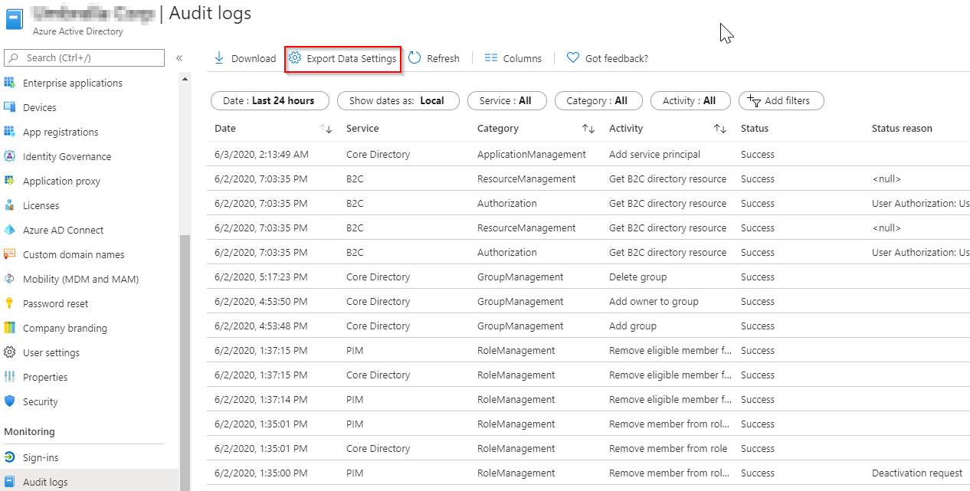
User, Groups & Audit Logs

Slide 51
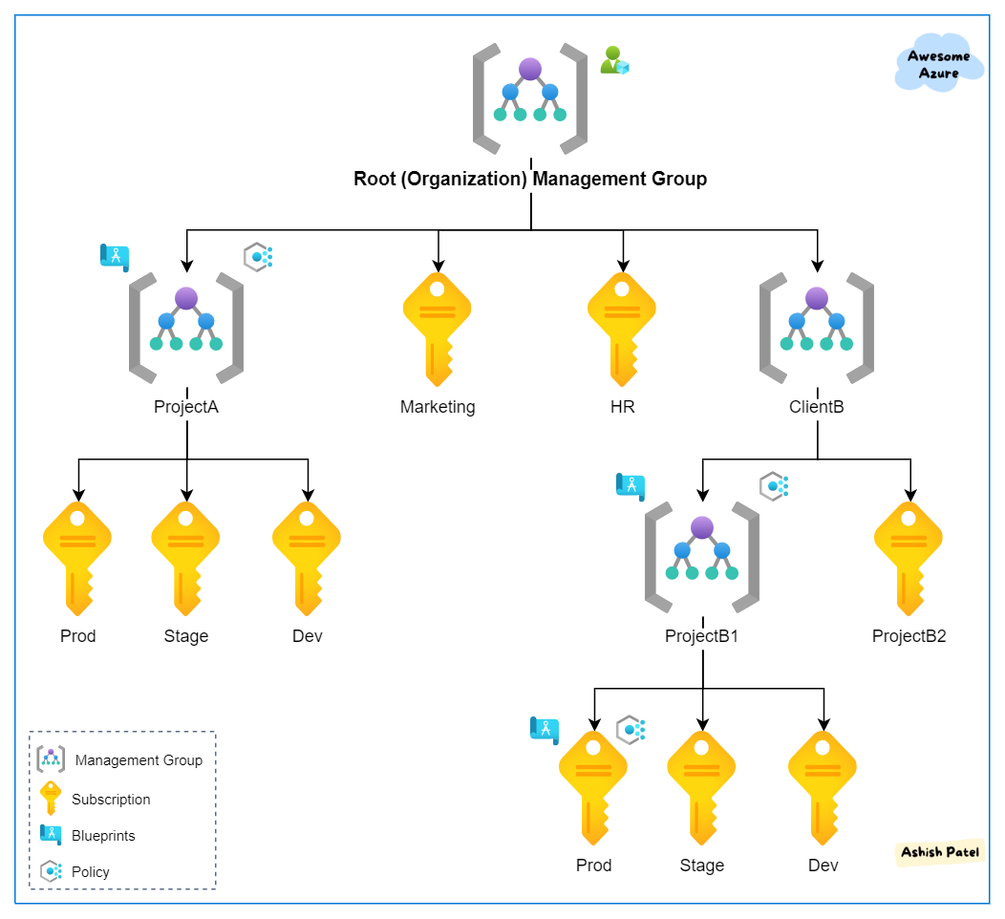
Manage Subscriptions

Slide 52
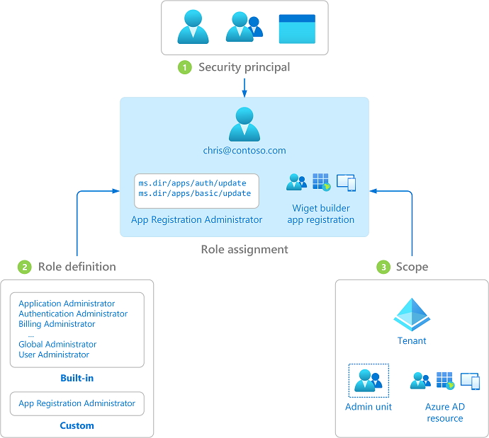
Role Base Access Control (RBAC)
Provides fine-grained access management of Azure resources.
Segregates duties within team and grant only the amount of access to users that they need to perform their jobs

Slide 53
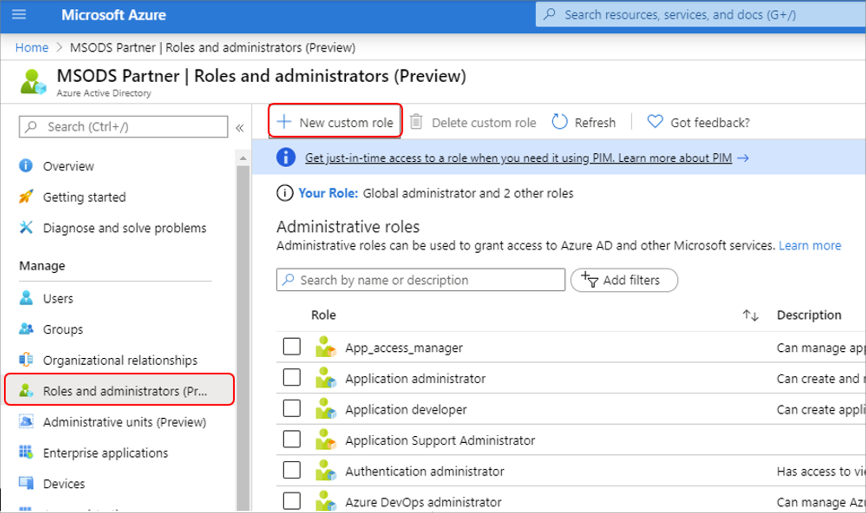
Custom Roles (RBAC)
If the Azure built-in roles don't meet the specific needs of your organization, you can create your own custom roles

Slide 54
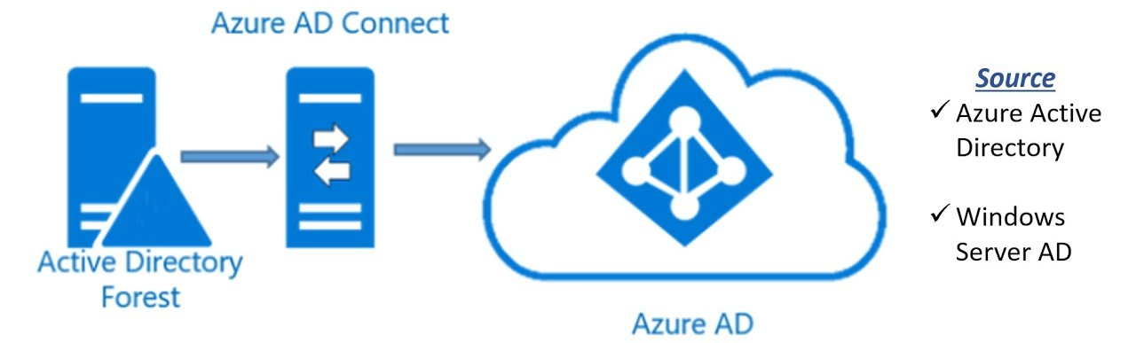
AD Connect Overview
To meet and accomplish hybrid identity goals

Slide 55
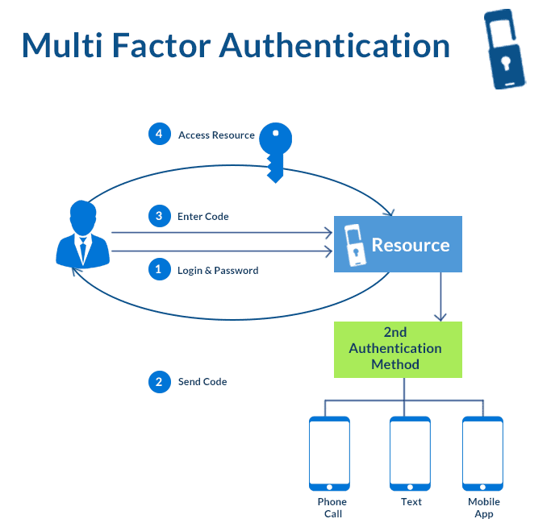
AD - Multifactor Authentication (MFA)
Multi-factor authentication is a process in which users are prompted during the sign-in process for an additional form of identification

Slide 56
Lab : Azure AD Authentication
Duration: 45 Minutes for all labs below
Lab: How to create management group?
Lab: How to manage Subscription?
Lab: How to create user and groups?
Lab: Implementation of permission
Lab: Implementation of MFA

Slide 57
DevOps strategy
Duration: 1-2 Hours including labs

Slide 58
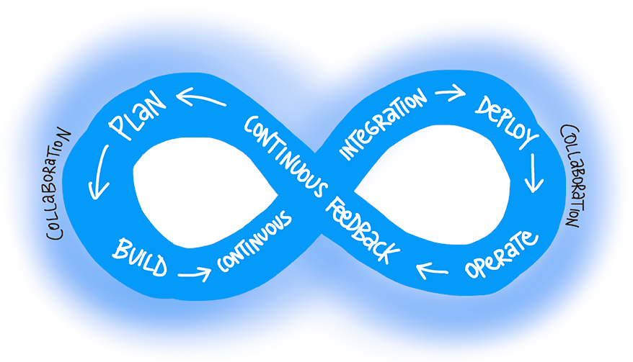
What is DevOps?
"DevOps is the union of people, process, and products to enable continuous delivery of value to end users."
– Donovan Brown, What is DevOps?
Notes:
https://docs.microsoft.com/en-us/azure/devops/learn/what-is-devops

Slide 59
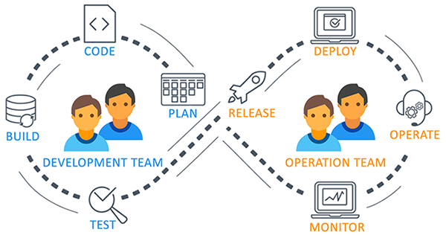
What is DevOps and Its use case?

Slide 60
Migration and consolidation strategy
Analyze Existing Artifact and Container Repositories
Analyze Existing Test Management Tools
Analyze Existing Work Management Tools
Recommend Migration and Integration Strategies for
Artifact Repositories
Source Control
Test Management and
Work Management

Slide 61

Migration and consolidation strategy

Slide 62
Migrate or integrate existing work management tools
Both Azure DevOps and GitHub can be integrated with a wide variety of existing work management tools:
Trello integration tooling is a free, flexible, and visual way to organize anything with anyone.
Solidify offers a tool for Jira to Azure DevOps migration.
Third party organizations offer commercial tooling to assist with migrating other work management tools like Aha, BugZilla, ClearQuest.

Slide 63

Migrate or integrate existing test management tools
Azure Test Plans are used to track sprints and milestones. There is a Test & Feedback extension available in the Visual Studio Marketplace.
Other tools:
Apache JMeter is open-source software written in Java and designed to load test functional behavior and measure performance.
Pester is a tool that can be used to automate the testing of PowerShell code.
SoapUI provides another testing framework for SOAP and REST testing.
If you are using Microsoft Test Manager, you should plan to migrate to Azure Test Plans
Notes:
For more information, you can see:
Marketplace search for test management - [(https://marketplace.visualstudio.com/search?term=test%20management&target=AzureDevOps&category=All%20categories&sortBy=Relevance)](https://marketplace.visualstudio.com/search?term=test%20management&target=AzureDevOps&category=All%20categories&sortBy=Relevance)

Slide 64
Identify project metrics and key performance indicators (KPIs)
Faster outcomes – Deployment frequency, deployment speed, deployment size, and lead time
Efficiency – Server to admin ratio, staff member to customers ratio, application usage, and application performance
Quality and security – Deployment failure rates, application failure rates, mean time to recover, bug report rates, test pass rates, defect escape rate, availability, service level agreement (SLA) achievement, and mean time to detection
Culture – Employee morale and retention rates
Goals must be specific, measurable, and time-bound

Slide 65
Secure development process

Slide 66
Tool integration strategy
Azure DevOps Services uses either a Microsoft account or Azure Active Directory, to protect and secure your data
For non-Microsoft tools like Git, NuGet, or Xcode you can use personal access tokens
Azure DevOps is pre-configured with default security groups and permissions
You can also configure app access policies and conditional access policies

Slide 67
Application configuration and secrets
Demonstration: 20-30 Minutes
Azure DevOps Variables
Azure App Settings
Azure Key Vault

Slide 68
Repository Management/Branch Management
Demonstration: 20-30 Minutes
Create the New repository
Create the Master branch
Create the Own Branches based on the developer requirement
Branch merging
Import Repository from Outside of the Azure DevOps to Azure DevOps
Creating Pull requests And Accepting Pull Requests

Slide 69
Azure Data Lake account
Duration: 10 Minutes

Slide 70
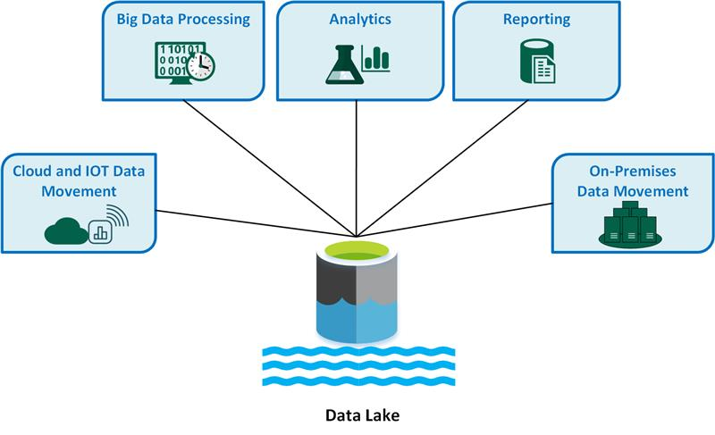
Azure Data Lake account

Slide 71
Azure Data Factory
Duration: 2-3 hours including labs

Slide 72
Azure Data Factory
Introduction
Top level Concepts in Azure Data Factory
Creating first data factory
Pipelines and Activity
Linked Services and Datasets
Copy Data Activity - Copy Specific file Within ADLS
Copy Data Activity – from ADL to SQL
Implementation of Triger

Slide 73
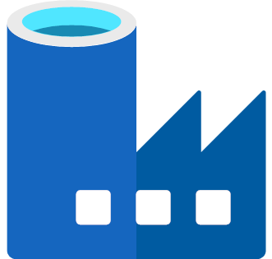
Data Factory Introduction
A powerful Cloud ETL tool
ETL/ELT tool.
Allow developers to integrate disparate data sources
Provides access to
On-premises
Cloud data

Slide 74
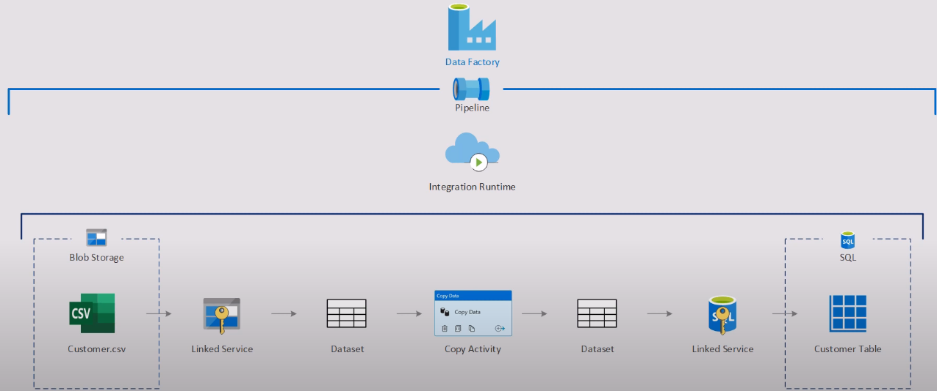
Top level Concepts in Azure Data Factory

Slide 75
ADF allows you to..
Move data
From on-premises and cloud sources to a centralized data store
Transform and integrate
Big data processing and machine learning
Has visual interface.
Invoke pipelines with
Manual
Event
Scheduling

Slide 76
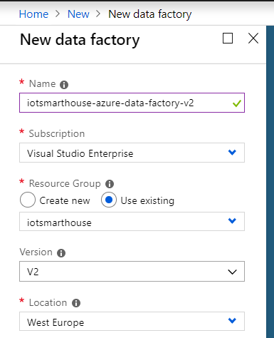
Demonstration: Create Azure Data Factory
First, you do not install it, you create a service in Azure by:
New -> Analytics -> Data Factory
Then, you need to set the
name,
select your subscription,
resource group,
version (1 or 2) and
location.

Slide 77
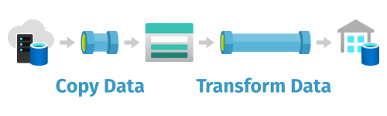
Pipeline
Logical grouping of activities that performs a unit of work
Together, the activities in a pipeline perform a task
For example
A pipeline can contain a group of activities that ingests data from an Azure blob, and
Then runs a Hive query on an HDInsight cluster to partition the data.

Slide 78
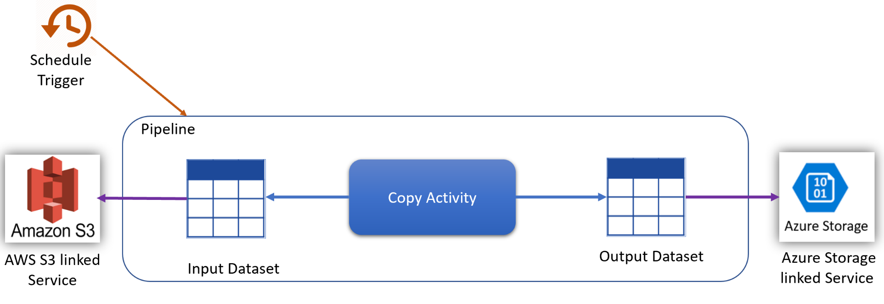
Activity
Represent a processing step in a pipeline
Example: Use a copy activity to copy data from one data store to another data store
Data Factory supports three types of activities
Data movement
Data transformation
Control activities

Slide 79
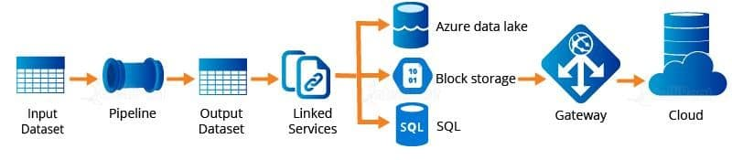
Datasets
Represent data structures within the data stores
It simply point to or reference the data you want to use in your activities as inputs or outputs.

Slide 80
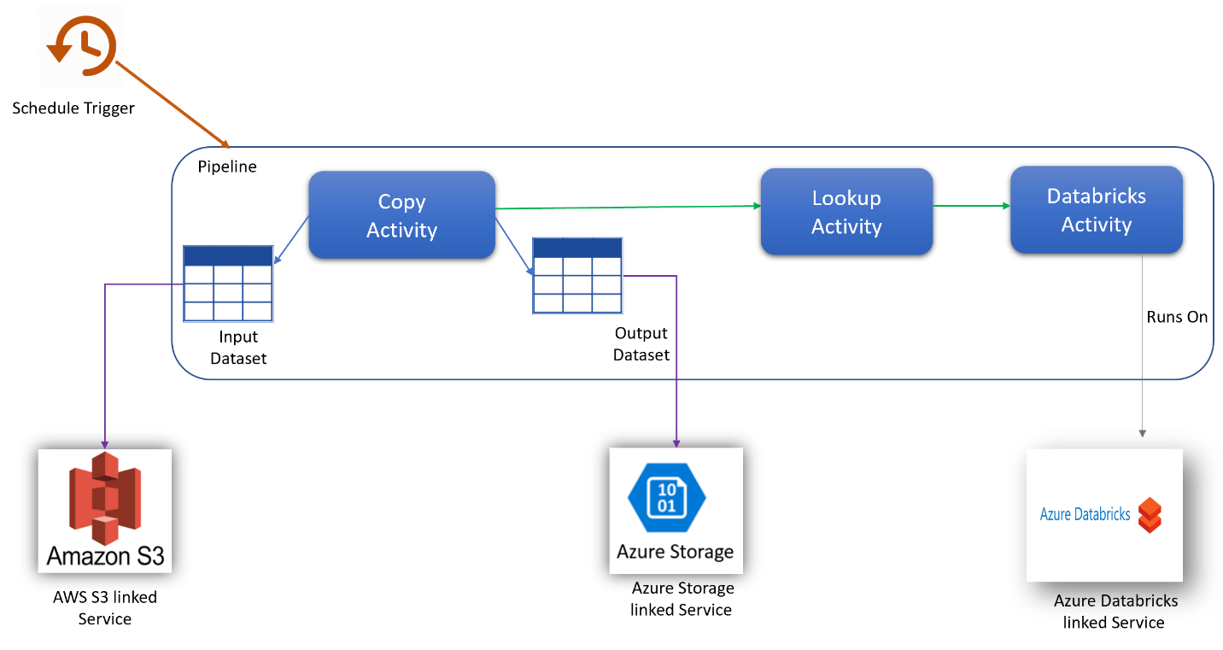
Linked services
Are much like connection strings, which define the connection information
It’s needed for Data Factory to connect to external resources

Slide 81
Triggers
Triggers represent the unit of processing that determines when a pipeline execution needs to be kicked off
There are different types of triggers for different types of events.

Slide 82
Copy Data Activity - Copy Specific file Within ADLS
Demonstration: 20 minutes

Slide 83
Copy Data Activity – from ADL to SQL
Demonstration: 20 minutes

Slide 84
Implementation of Triger
Demonstration: 10 minutes

Slide 85
Azure Data Bricks
Duration: 6-8 Hours including labs

Slide 86
Describe Azure Data Bricks
Introduction
Explain Azure Data Bricks
Create an Azure Databricks Workspace and cluster
Understand Azure Databricks Notebooks
Exercise: Work with Notebooks

Slide 87
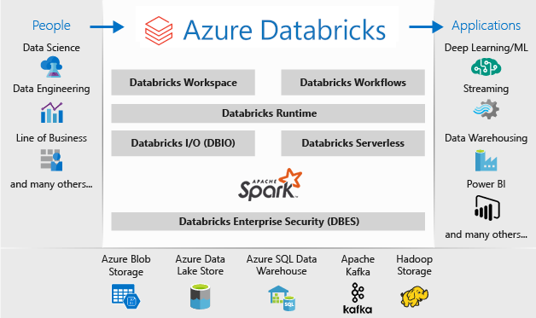

Slide 88
Spark Architecture fundamentals
Introduction
Understand the architecture of Azure Databricks spark cluster
Understand the architecture of spark job

Slide 89
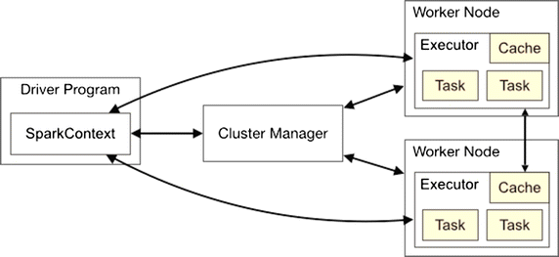
Spark Architecture

Slide 90
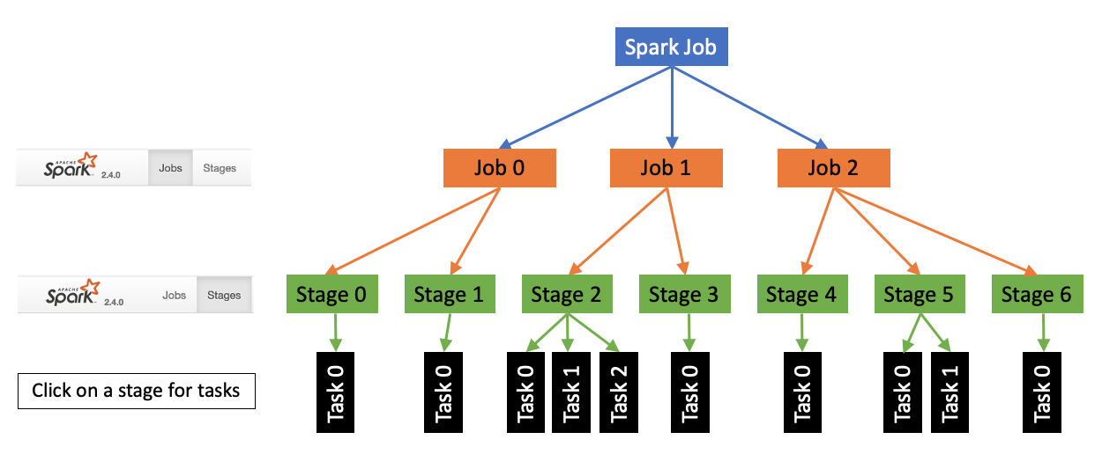
Spark Job

Slide 91
Read and write data in Azure Databricks
Introduction
Read data in CSV file
Read data in JSON file
Read Data in Parquet file
Read Data stored in tables and views
Write data
Exercise: Read and write data

Slide 92
Work with DataFrames in Azure Databricks
Introduction
Describe a DataFrame
Use Common DataFrame Methods
Use the display function
Exercise: Distinct articles

Slide 93
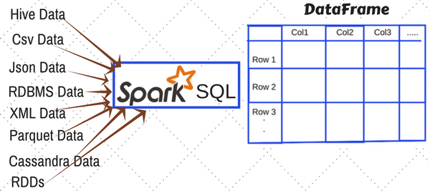
DataFrame in Spark

Slide 94
Describe lazy evaluation and other performance features in Azure databricks
Introduction
Describe the difference between eager and lazy execution
Describe the fundamentals of how the Catalyst Optimizer works
Describe and identify actions and transformations
Describe performance enhancements by shuffle operations and Tungsten

Slide 95
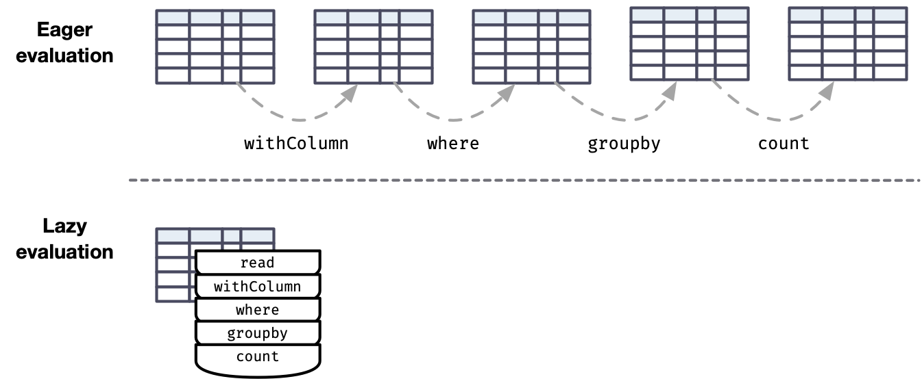
Lazy and Eager Evaluation

Slide 96
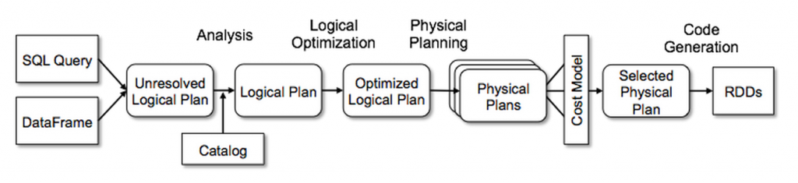
Spark Catalyst Optimizer

Slide 97
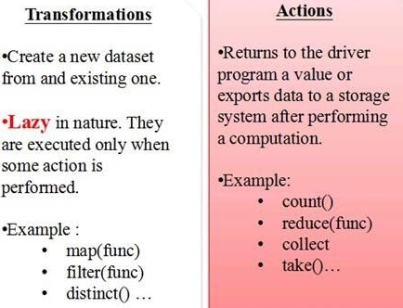
Identify Transformation and Action

Slide 98
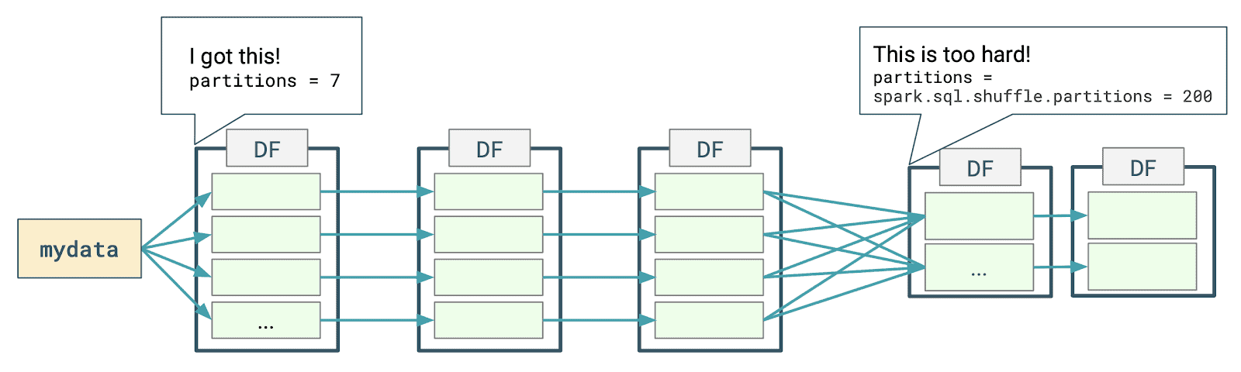
Shuffle Operations

Slide 99
Tungsten
Codename for the umbrella project to make changes to Apache Spark's execution engine
It focuses on substantially improving the efficiency of memory and CPU for Spark applications
property:
spark.sql.tungsten.enabled to true

Slide 100
Work with Dataframes Columns in Azure Databricks
Introduction
Describe the columns class
Work with Columns expressions

Slide 101
Work with DataFrames advanced methods in Azure Databricks
Introduction
Perform date and time manipulations
Use aggregate functions
Exercise: Deduplication of data

Slide 102
Describe platform architecture, security and data protection in Azure Databricks
Describe Azure key vault and Databricks security scopes
Secure access with Azure IAM and authentication
Describe security
Exercise: Access Azure storage with key vault backed secrets

Slide 103
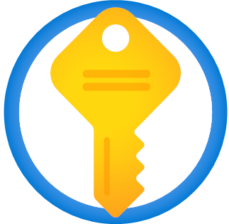
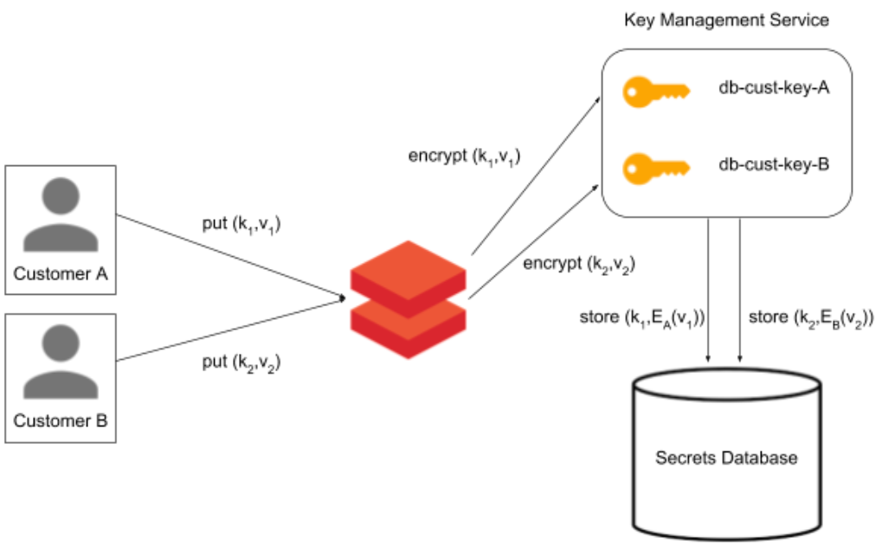
Describe Azure key vault and Databricks security scopes
Azure Key Vault
A cloud service for securely storing and accessing secrets
Databricks security scopes
Collection of secrets identified by a name
Stored in an encrypted database owned and managed by Databricks

Slide 104
Secure access with Azure IAM and authentication
Lab
Duration: 20-30 minutes

Slide 105
Describe security
Lab
Duration: 10-20 minutes

Slide 106
Describe Databricks Delta Lake architecture
Introduction
Describe bronze, silver, and gold architecture
Perform batch and stream processing

Slide 107
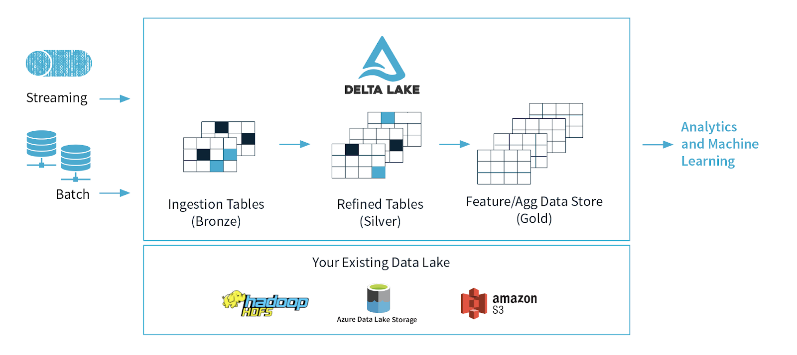
Delta Lake

Slide 108
Perform batch and stream processing
Lab
Duration: 30-40 minutes

Slide 109
Create production workloads on Azure Databricks with Azure Data Factory
Introduction
Schedule Databricks jobs in a data factory pipeline
Pass parameters into and out of Databricks jobs in data factory

Slide 110

Introduction

Slide 111
Schedule Databricks jobs in a data factory pipeline
Duration: 10-20 minutes

Slide 112
Pass parameters into and out of Databricks jobs in data factory
Duration: 10-20 minutes

Slide 113
Kubernetes
Duration: 2 Hours including demonstration

Slide 114
Azure Kubernetes Services
Introduction of Kubernetes
Deploy Azure Kubernetes Service in Subscription
Configure Networking in AKS Deployment
Integration of AKS with Azure Container Registry

Slide 115

Introduction of Kubernetes
Opensource platform for managing containerized workloads and services

Slide 116
Deploy Azure Kubernetes Service in Subscription
Demonstration

Slide 117
Configure Networking in AKS Deployment
Demonstration

Slide 118
Integration of AKS with Azure Container Registry
Demonstration

Slide 119
Thanks

